Slide 1
On the Complexity Measures of Genetic Sequences

Slide 2
Abstract
The regulatory regions of genomes are rich in direct, symmetric and complemented repeats.
And there is no doubt about the functional significance of these repeats.

Slide 3
Introduction(1)
In Ziv-Lempel complexity measure reflects,
two operations are allowed : generation of a new symbol, and copying a fragment from the part of the sequence that has already been synthesized.

Slide 4
Introduction(2)
We show that these measures can be used for recognition of the local structural regularities in DNA sequence.

Slide 5
Systems and Methods
- Preliminaries(1)
Let A be a finite alphabet of cardinality n. A string S of length N over the alphabet A is an ordered N-tuple S = s1s2…sN of symbols from A.
Ex: A={A,G,C,T}
S1 = AGC
S2 = TGCCA

Slide 6

Preliminaries(2)
Denote by S[i:j] a substring sisi+1…sj of S which starts at position i and ends at position j.
For each j,1 j N, S[1:j] is called a prefix of S;S[1:j] is a proper prefix of S if j< N

Slide 7
Preliminaries(3)
Ziv and Lempel define the complexity measure, CLZ(S),of a non-empty sequence S as the minimal number of steps in some(optimal) procedure of its synthesis
H(S) = S[1:i1]S[i1+1:i2]…S[ik-1+1:ik]…
S[im-1+1:N]

Slide 8
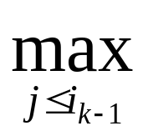
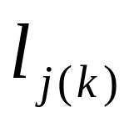


Preliminaries(4)
A component of length
ik - ik-1 = { lj : S[ik-1+1:ik-1+lj]
= S[j : j+lj-1] }
S[ ik-1+1 : ik ]
= S[j(k) : j(k)+ - l]S[ ] if j(k) 0
S[ik-1+1] if j(k) = 0
where j(k) denotes the first position of the fragment to be copied at step k
{

Slide 9
Dependence of Complexity on the Set of Permissible Operations
Let’s consider the fragment
S = ABBABAABBAABABBA
H(S)=A•B • BA • BAA • BBAA • BABB • A
CLZ(S)=7
fragment to be copied are underlines or overlined

Slide 10
Dependence of Complexity on the Set of Permissible Operations
If the uniqueness of the components is not required then the longest fragment can be copied without generating a new symbol.
H1(S)=A•B • B • AB • A • ABBA • ABA • BBA
C1(S)=8

Slide 11
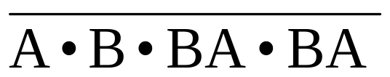
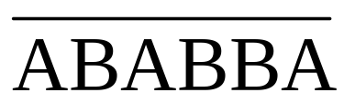
Dependence of Complexity on the Set of Permissible Operations
If instead of direct copying, only symmetric copying(from right to left) is allowed,then
H2(S)= • ABBA •
C2(S)=6

Slide 12
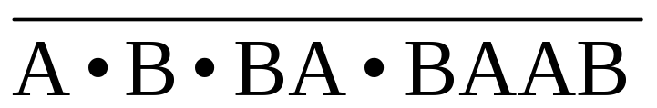
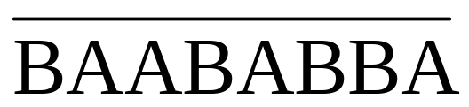
Dependence of Complexity on the Set of Permissible Operations
Obviously, the second part of sequence S is an exact repeat of the first part if A is substituted by B, and B by A.
H1(S)= •
C1(S)=5

Slide 13
Algorithm(1)
Tree structure
All L-tuple occurring in S, along with their start positions, can be represented by a tree structure known as trie.
(L < estimated length of the average length of the longest repeat )

Slide 14
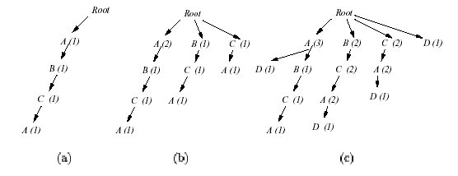
Trie
Suppose we have two segment ABCA and BCAD

Slide 15

Algorithm(2)
(i) D < L and the vertex is not a leaf.Then the length of the fragment to be copied is D
(ii) D = L and the vertex is a leaf labeled by ( n1,n2,…nm( ) ). This means S[j+1:j+L] occors in positions n1,n2,…nm( ) of the text S[1:j].

Slide 16
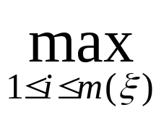
Algorithm(3)
To determine whether D = L or D > L,each L-tuple S[ni:ni+L-1], 1 i m( ) must be extend and compared with the fragment of the text.
D* = (Di | S[ni : ni+L-1+Di]
=S[j+1 : j+l+Di])
the length of the longest fragment
D = L + D*

Slide 17

Algorithm(4)
Search for the longest symmetric fragment
The length D of the fragment to be copied is known in advance.
Based on construction of an tree (j) for the text S[1:j].

Slide 18
Algorithm(5)
Search for the longest isomorphic fragment
Use both TR(j) and (j)
Algorithm the same as described above

Slide 19
Conclusion
Improve the compression ratio of the text
These measure can be used for recognition of structural regularities in DNA sequence.

